Slide 1
Attractor models
Partly taken from: Martino Sorbaro, TReND–CaMinA 2024; Johan John, MIT course; Seth W. Egger

Slide 2
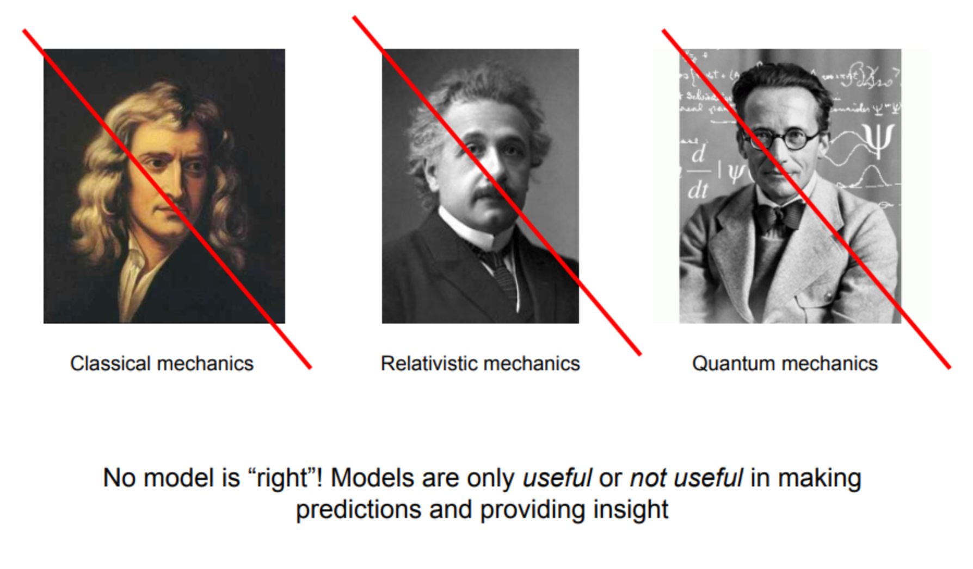
A general note on models

Slide 3
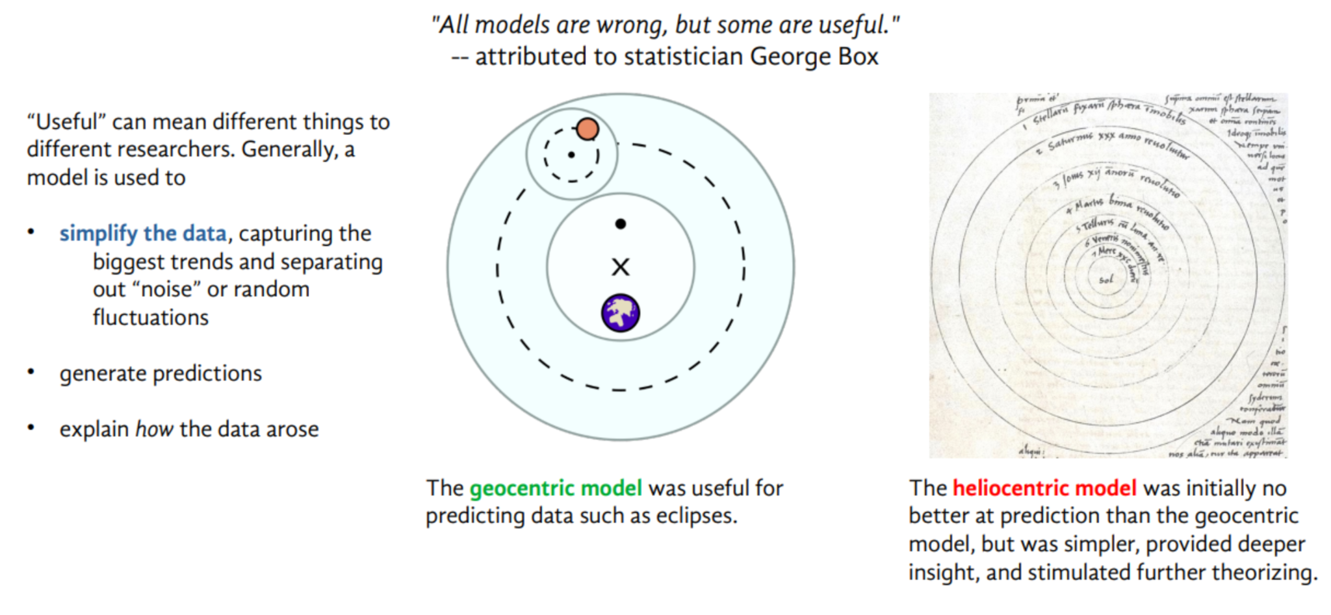
A general note on models

Slide 4
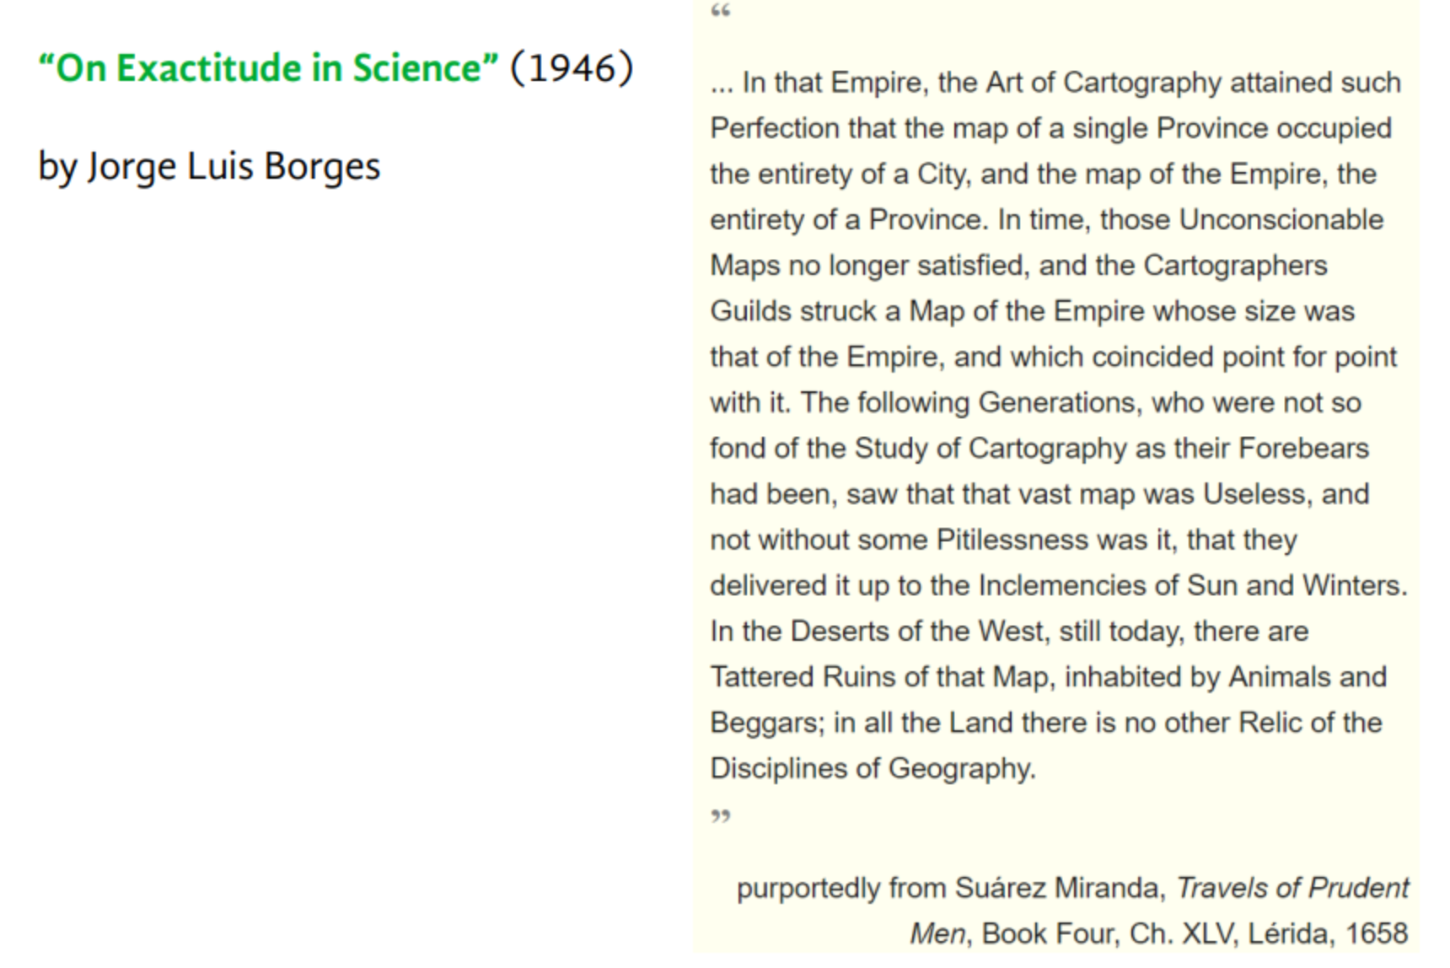
A general note on models

Slide 5
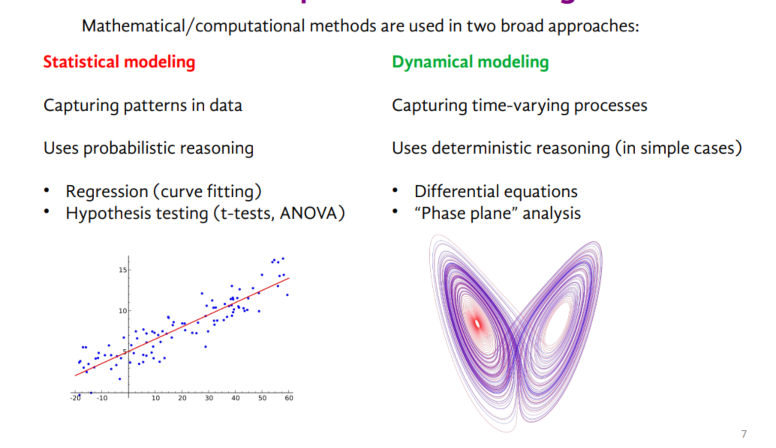
Models in Neuroscience

Slide 6
Models in Neuroscience

Slide 7
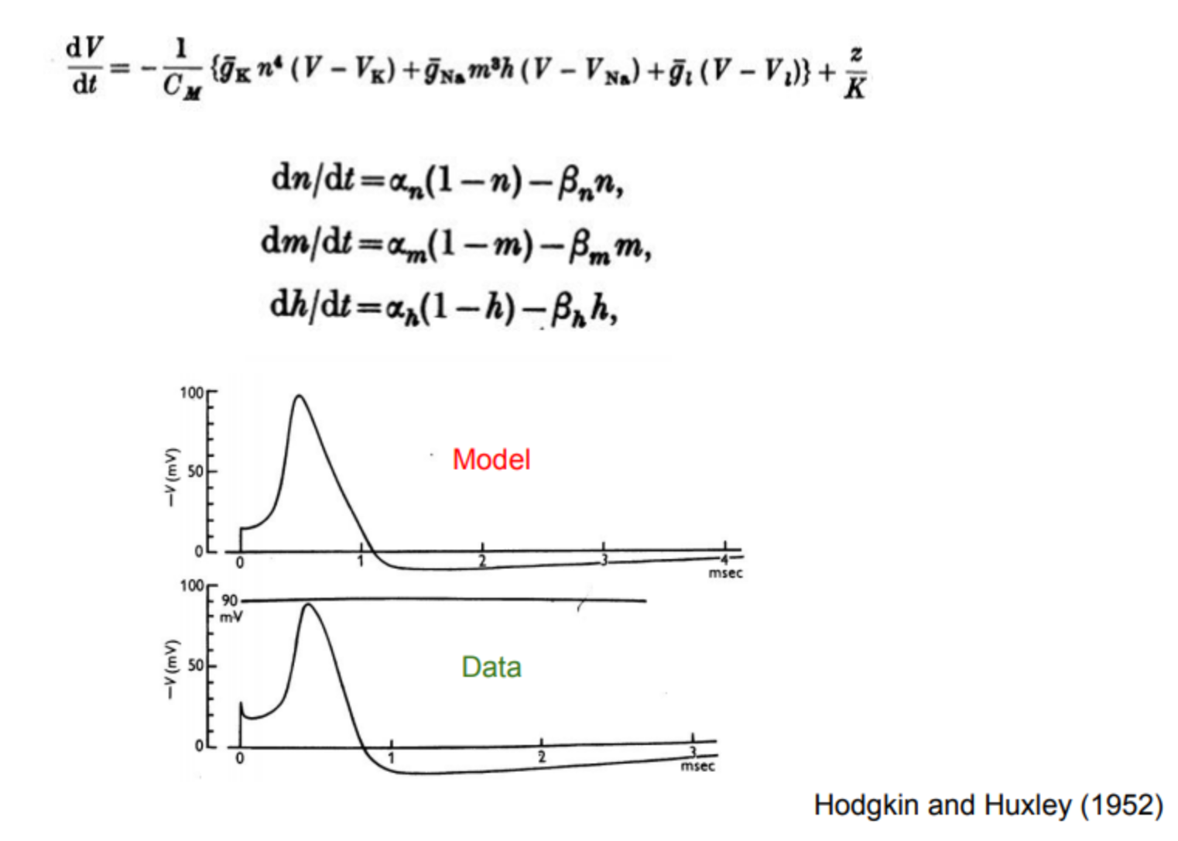
The Hodgkin-Huxley model

Slide 8
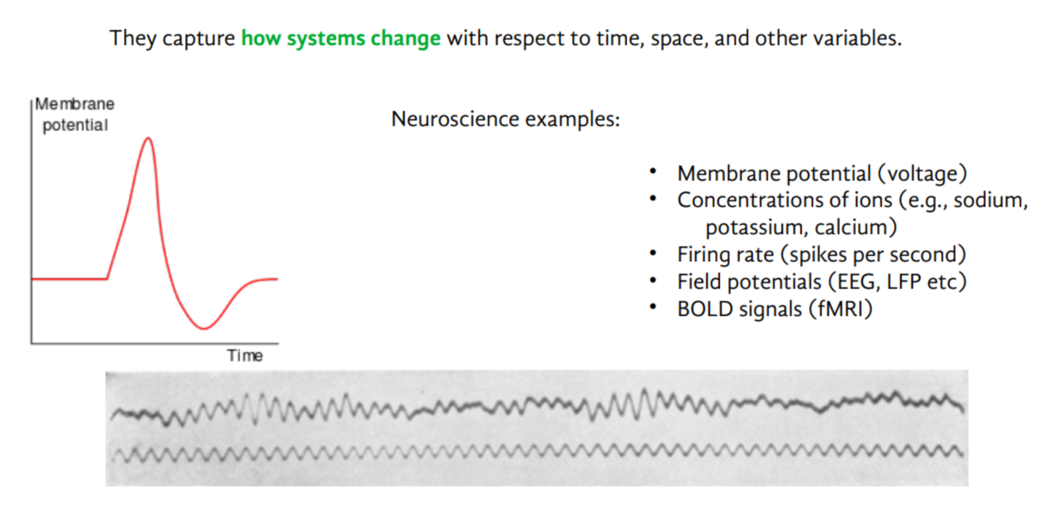
Dynamical systems

Slide 9
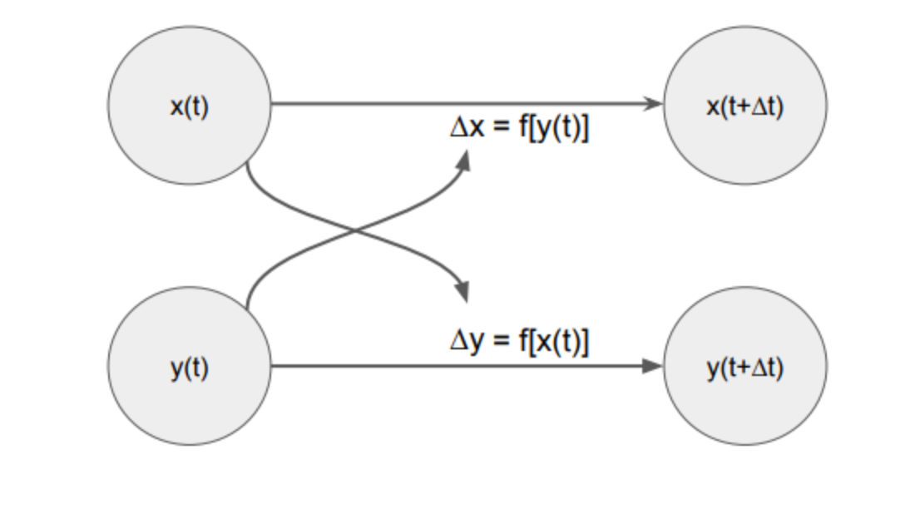
Dynamical systems

Slide 10
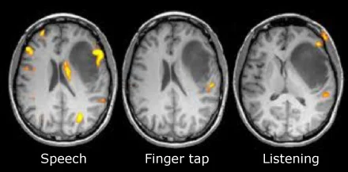
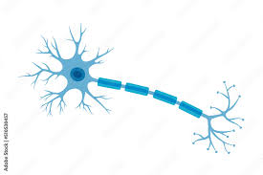
States
The concept of state is important in contemporary physics. It’s needed to talk about how systems evolve in time.
How do we describe the state of a person?
And the state of a brain?
Of a neural network?
Of a single neuron?
We can think of states at different spatial scales.

Slide 11
Dynamics
States evolve in time based on interactions with the external world.
The evolution of the state in time is called dynamics.
How can we describe the dynamics of a neural system?
What mathematical or computational tools can we use?
We can think of dynamics at different temporal scales.

Slide 12
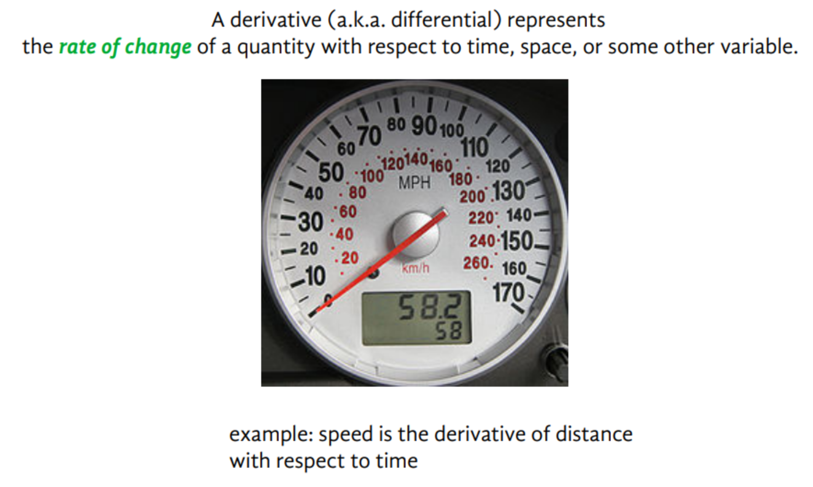
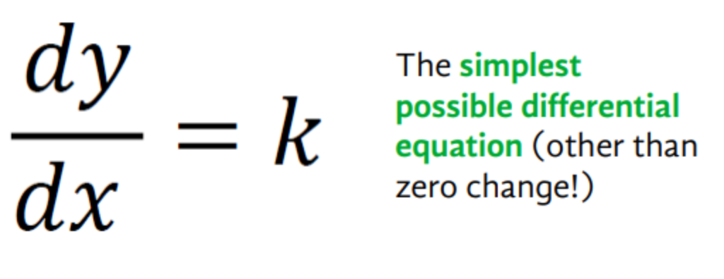
The derivative

Slide 13
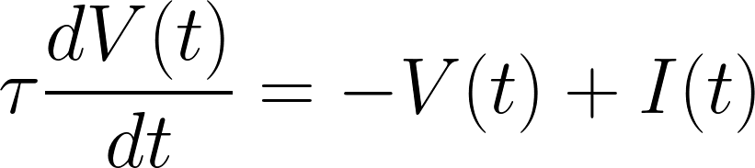
A differential equation
Where have we seen this before?
What is the unknown variable in this equation?

Slide 14
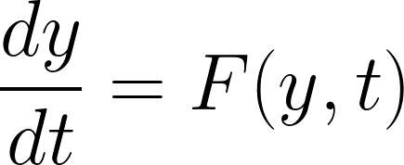

General form of a first-order differential equation
Rate of change of “state” y in time
also written as
Depends on the state and on other time-dependent stuff

Slide 15
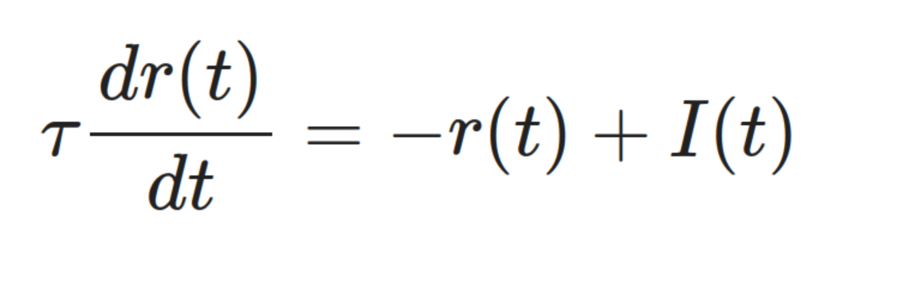
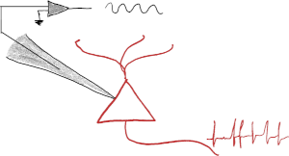
The ODE for a neuron, or a neural population
For a neuron V represents its membrane voltage. For a population r represents its firing rate.
What is this equation telling us?
What do you expect the solution to look like?
How does the population evolve in time?

Slide 16
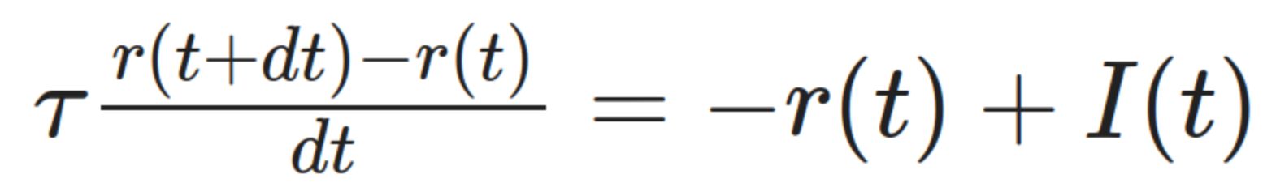
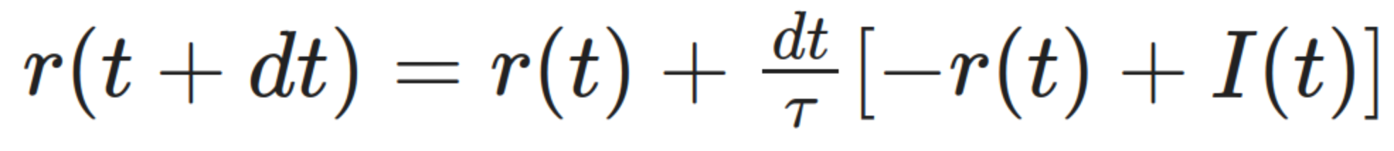
Numerical solutions: the forward Euler method
Discretize time dt to a small value
Rearrange
New state
from previous state

Slide 17
Let’s code this up!

Slide 18
import numpy as np
import matplotlib.pyplot as plt
dt = 0.001 # time step, in s
time = np.arange(0, 0.1, dt) # step times of the whole simulation, in s
Nt = len(time) # total number of steps in simulation
input = 10*np.ones((Nt,)) # input current
tau = 0.02 # membrane time constant, in s
# initialize firing rate at 1
rate = np.ones((Nt,))
# simulation loop, through all time steps
for i in range(Nt-1):
rate[i+1] = rate[i] + dt/tau*(-rate[i] + input[i])
plt.plot(time, rate)

Slide 19
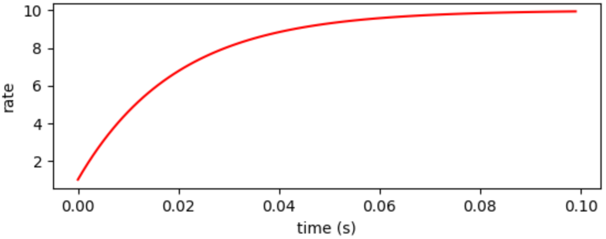
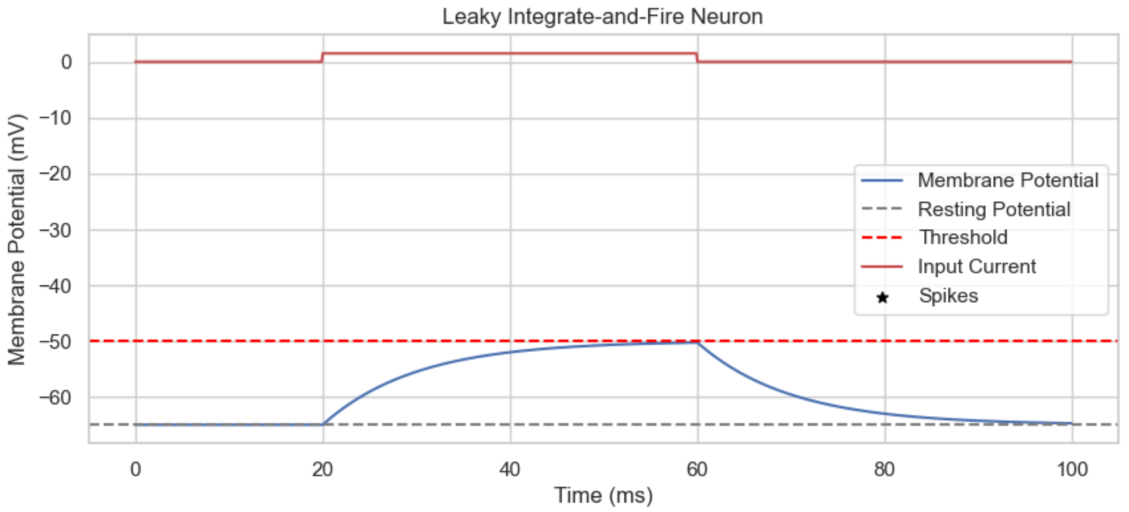

Slide 20
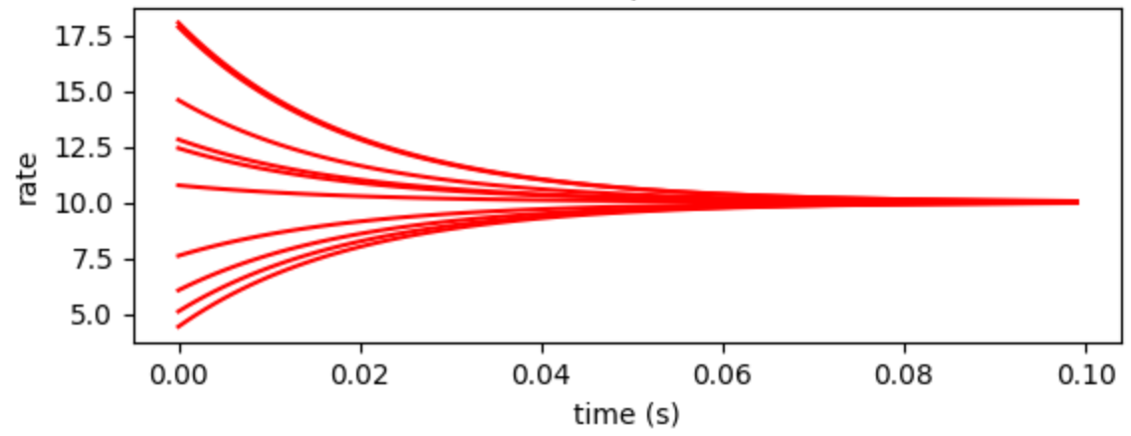

Slide 21
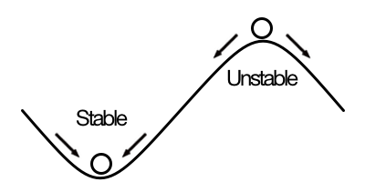
Equilibrium points

Slide 22
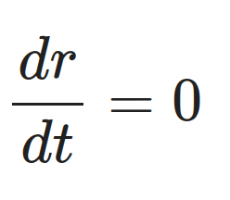
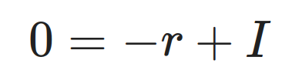
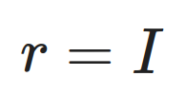
Equilibrium points: attractors
We noticed that all solutions tend to the value I.
This is called a point attractor, or stable fixed point, or stable equilibrium.
Fixed points are the ones where the derivative is zero, and so the state does not change in time.
Stable fixed point

Slide 23
Attractor network models
Excitatory feedback network
Inhibitory-excitatory network
Double-well attractor
Ring attractor network
Slower dynamics: memory, integration
Inhibition stabilization: memory
Selective memory, decision making
Continuous memory

Slide 24
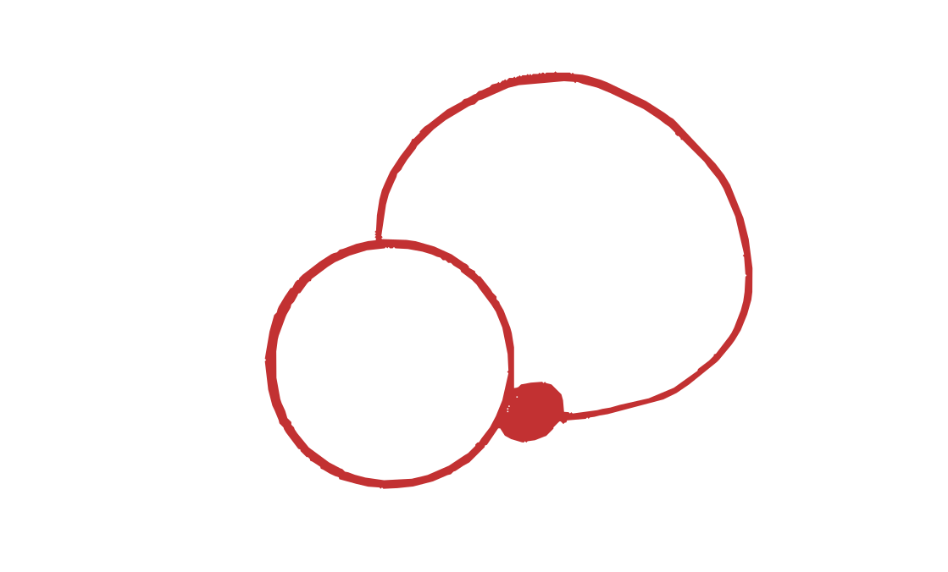
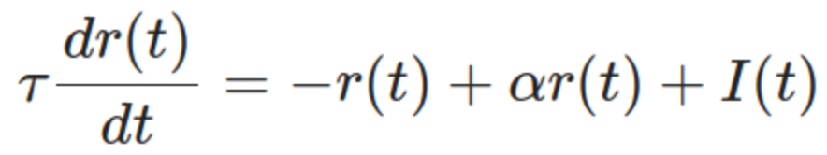
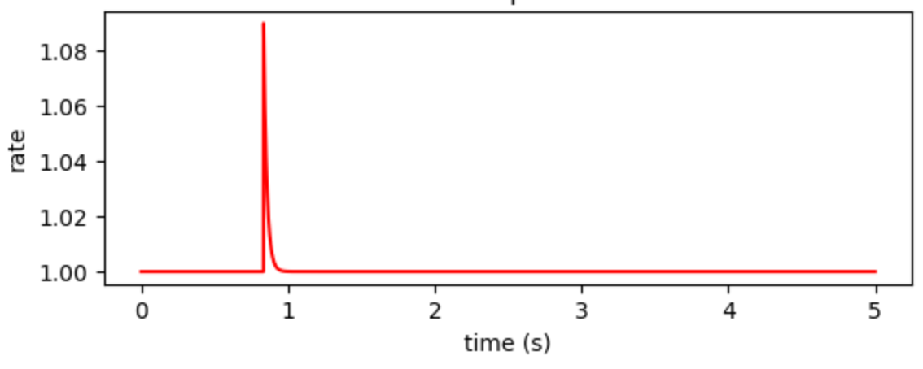
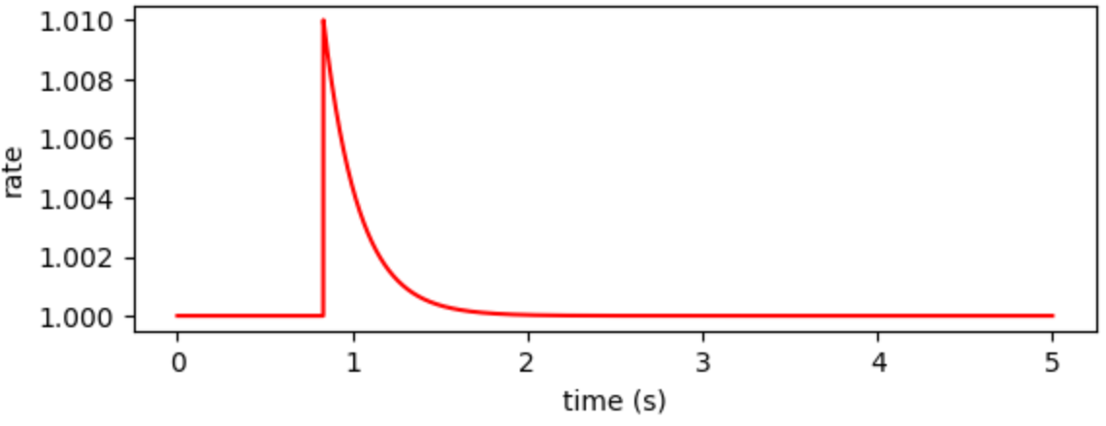
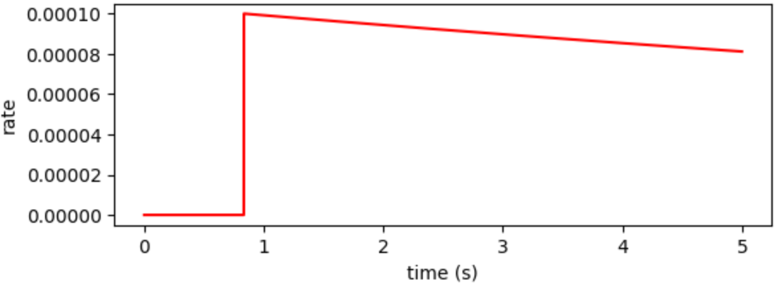
Excitatory feedback network
α
The simplest network model is a neuron/population that excites itself.
This auto-excitation is a fundamental mechanism in attractor network function.
It effectively slows down the dynamics.
α = 0.1
α = 0.9
α = 0.999

Slide 25
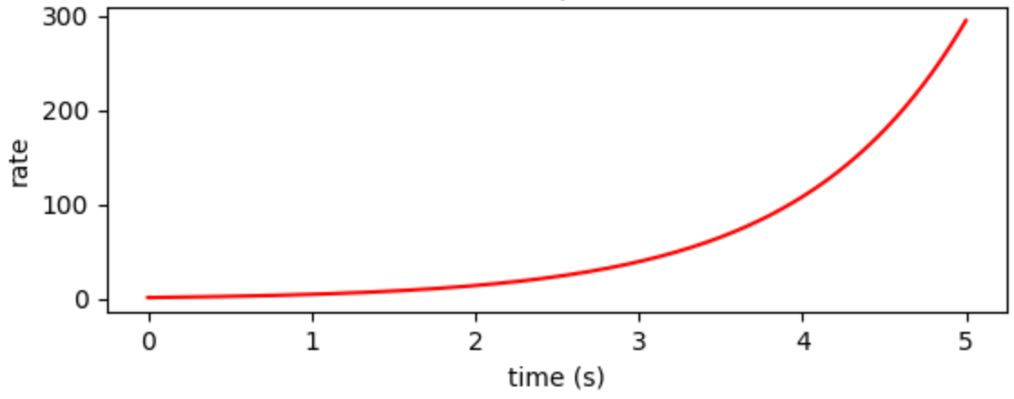
Excitatory feedback network
α
The simplest network model is a neuron/population that excites itself.
This auto-excitation is a fundamental mechanism in attractor network function.
It effectively slows down the dynamics. BUT it is highly unstable!
α = 0.999
α = 1.02

Slide 26
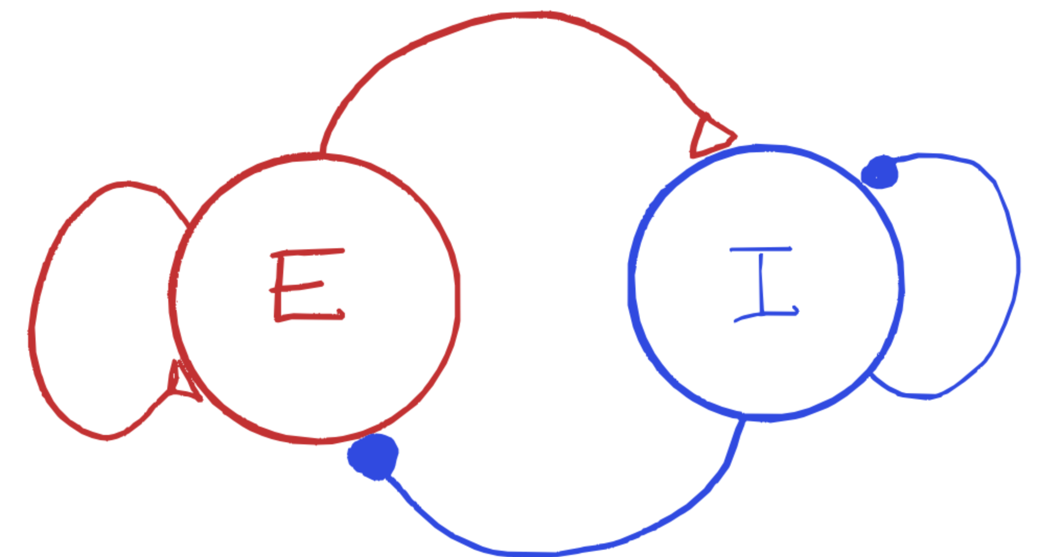
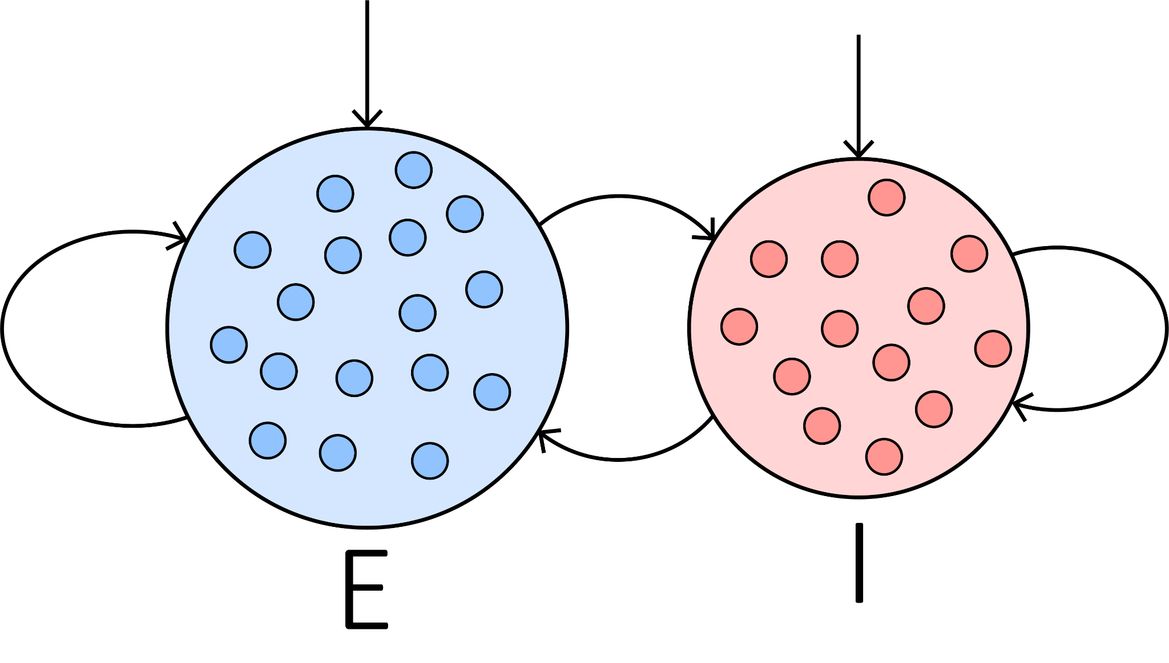
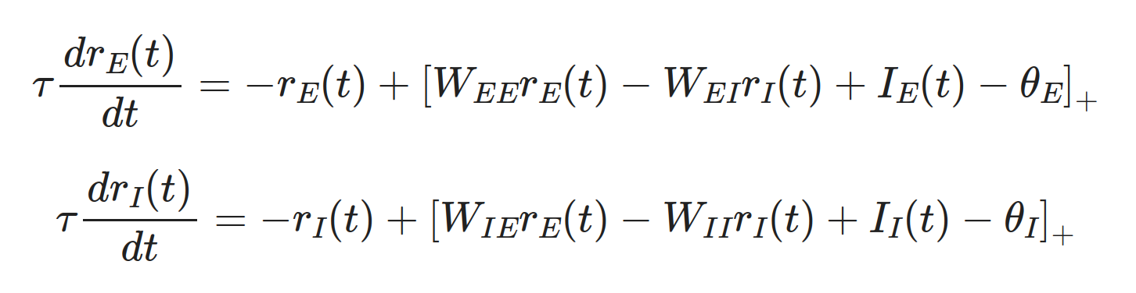
Excitatory-inhibitory networks
i
i
c
a
d
b
Wilson and Cowan 1972

Slide 27
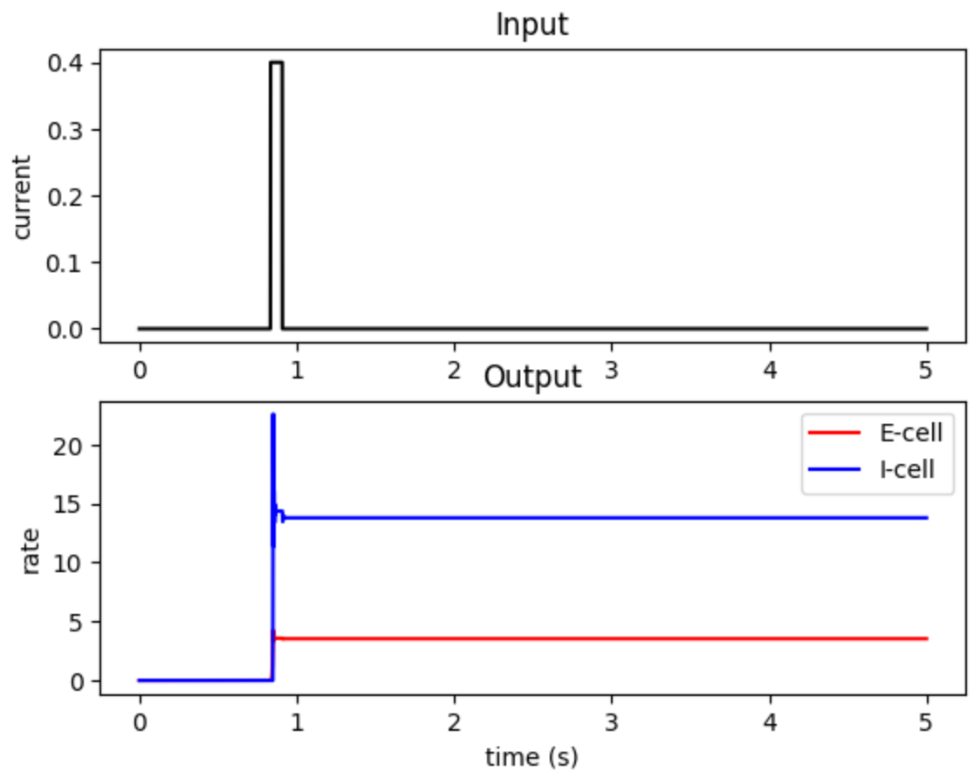
Excitatory-inhibitory networks: inhibition stabilized networks

Slide 28
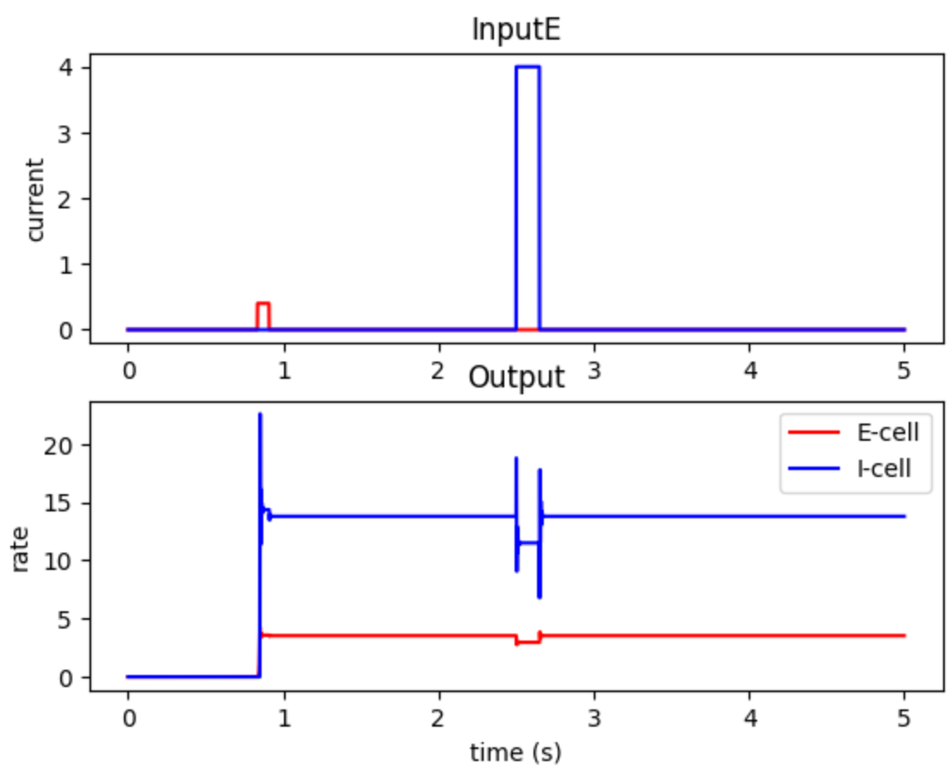
Excitatory-inhibitory networks: inhibition stabilized networks
Ozeki et al. Neuron 2009

Slide 29
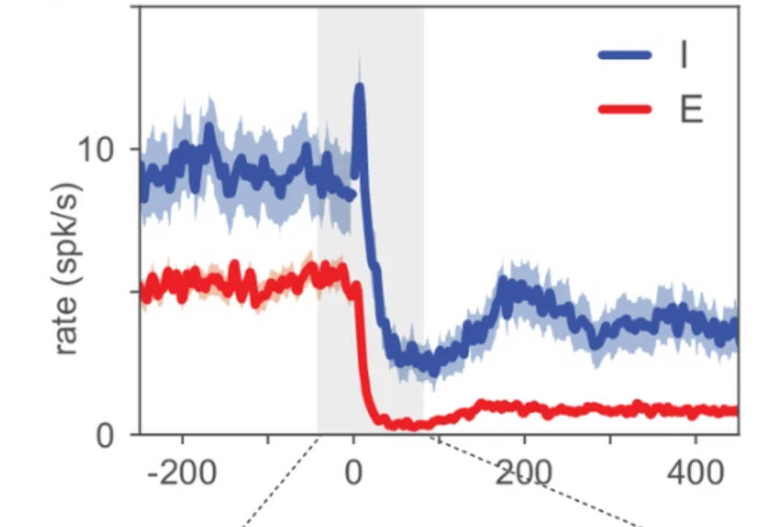
Excitatory-inhibitory networks: inhibition stabilized networks
Sanzeni et al. ELife 2020
Ozeki et al. Neuron 2009

Slide 30
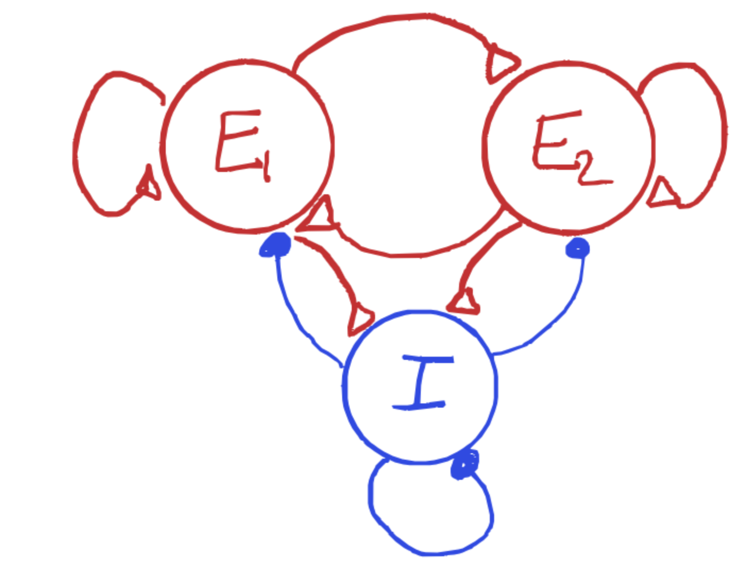
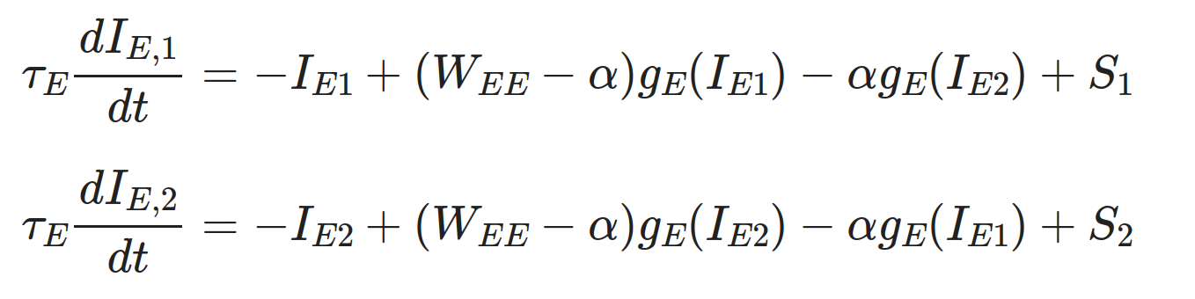
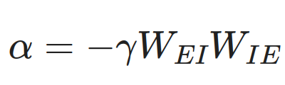
Double-well attractor model

Slide 31
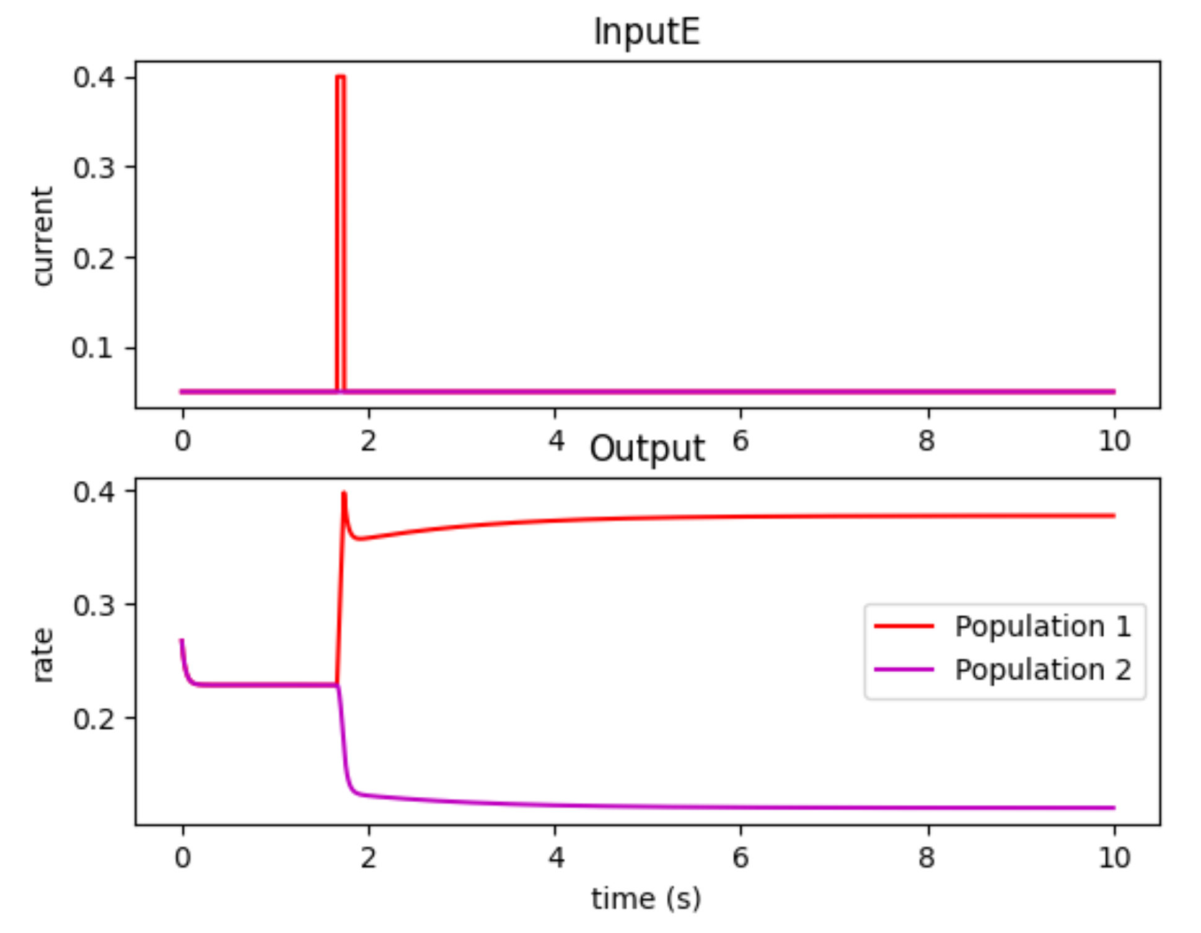
Double-well attractor model: selective memory

Slide 32
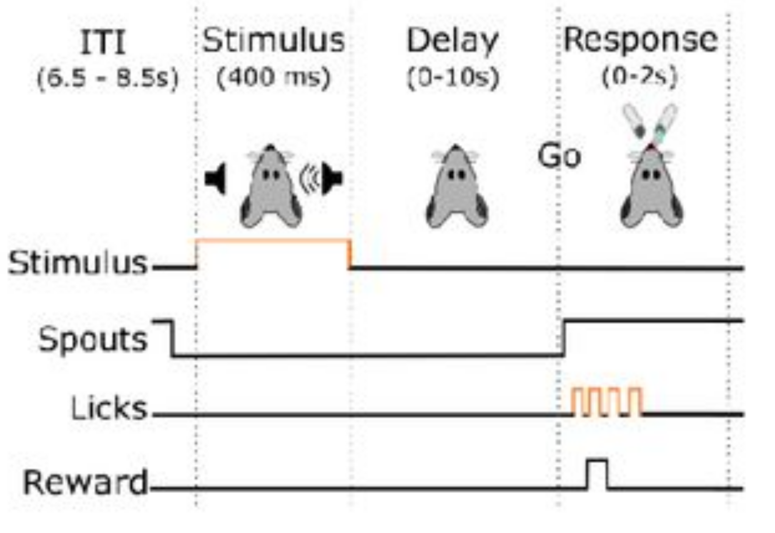
Double-well attractor model: selective memory
Oña-Jodar et al. bioRxiv 2024

Slide 33
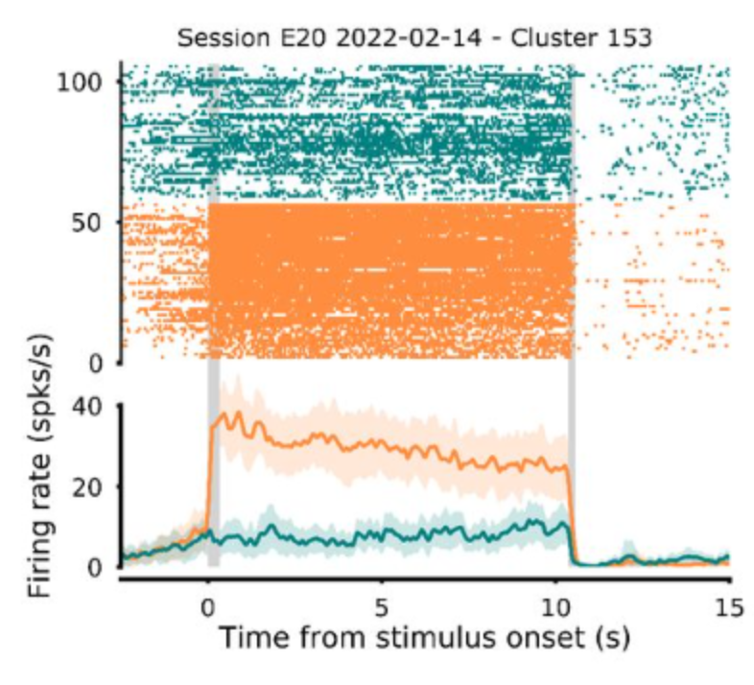
Double-well attractor model: selective memory
Oña-Jodar et al. bioRxiv 2024

Slide 34
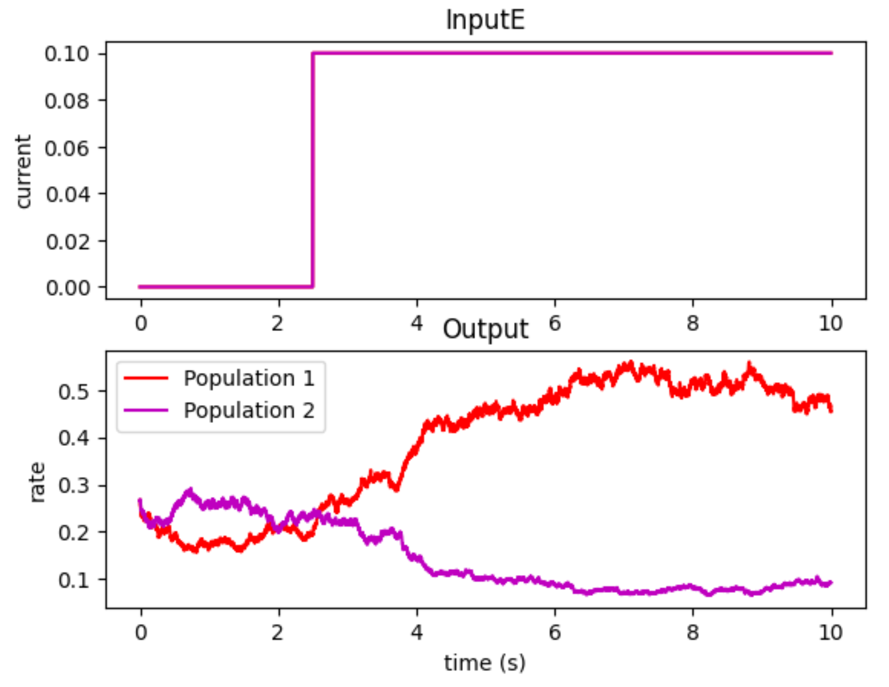
Double-well attractor model: decision making

Slide 35
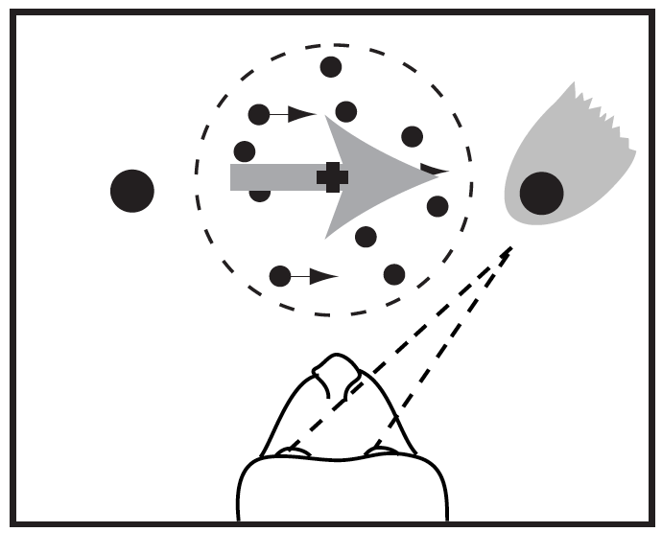
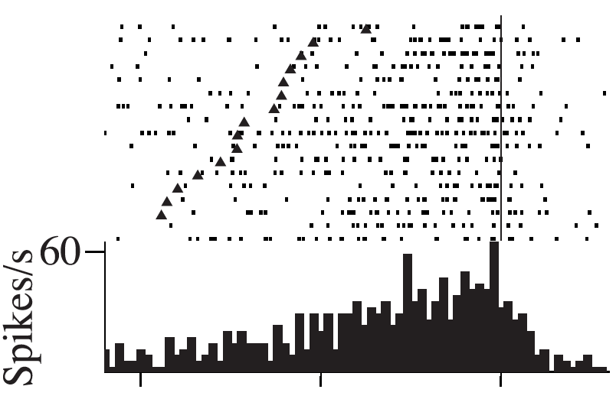
Double-well attractor model: decision making
-1000 -500 0
Newsome et al., 1989; Britten et al 1996; Shadlen et al 1996; Zohary et al 1994
Time from response (s)

Slide 36
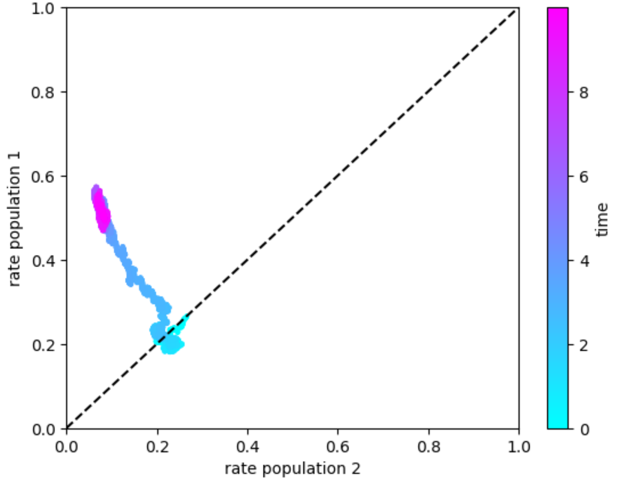
Double-well attractor model: decision making

Slide 37
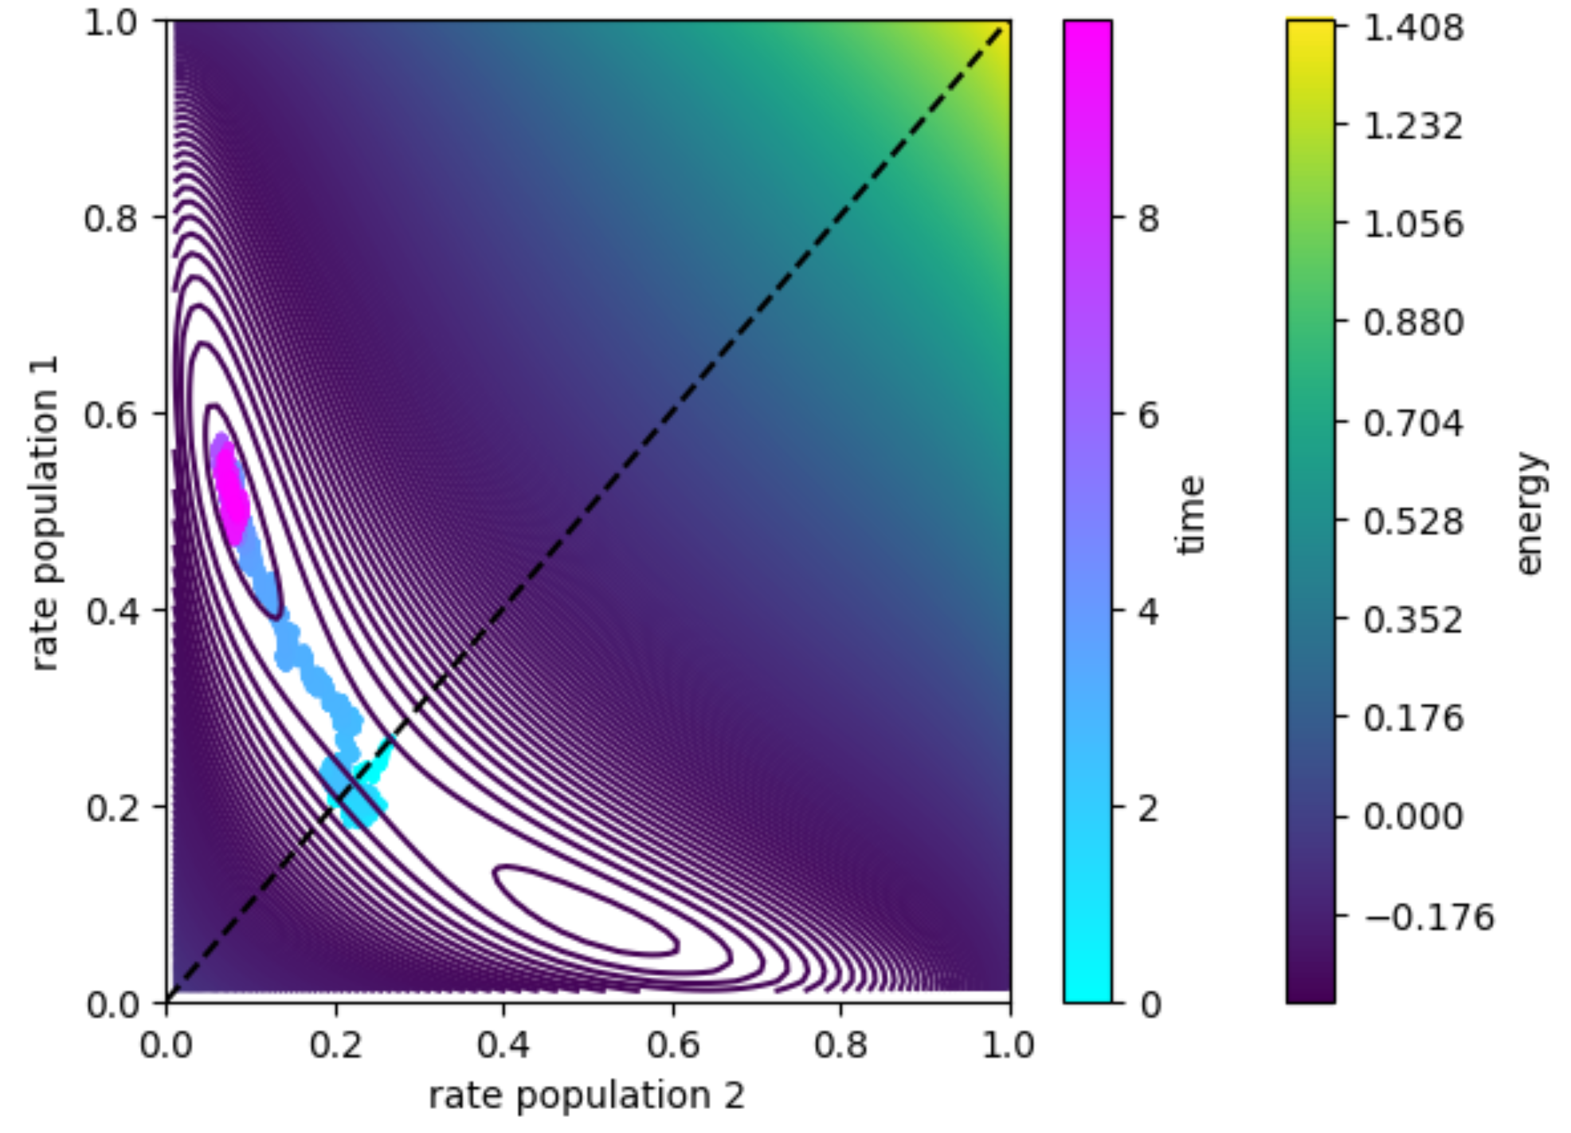
Double-well attractor model: decision making

Slide 38
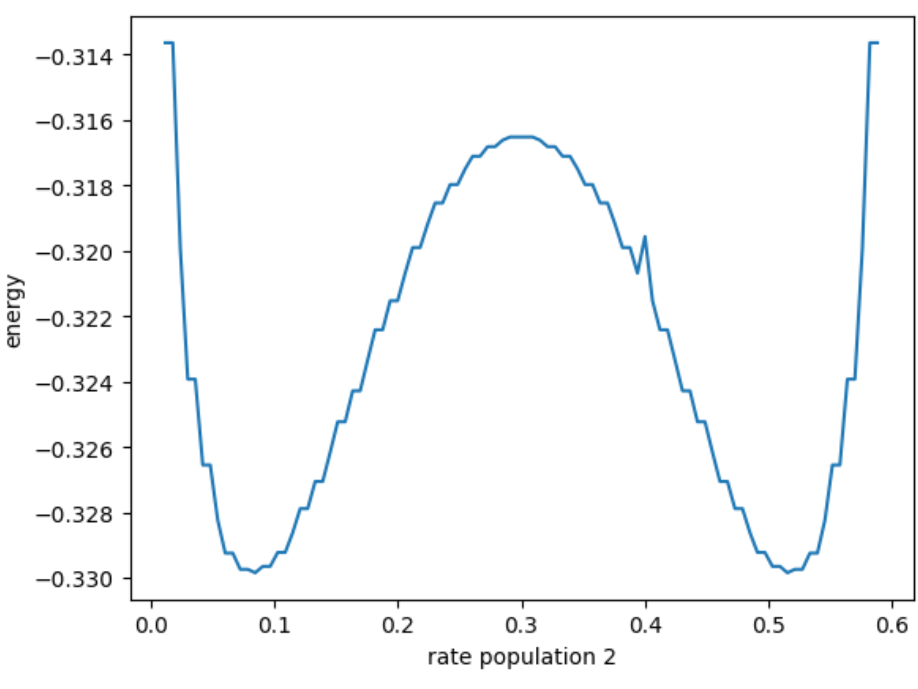
Double-well attractor model: decision making

Slide 39
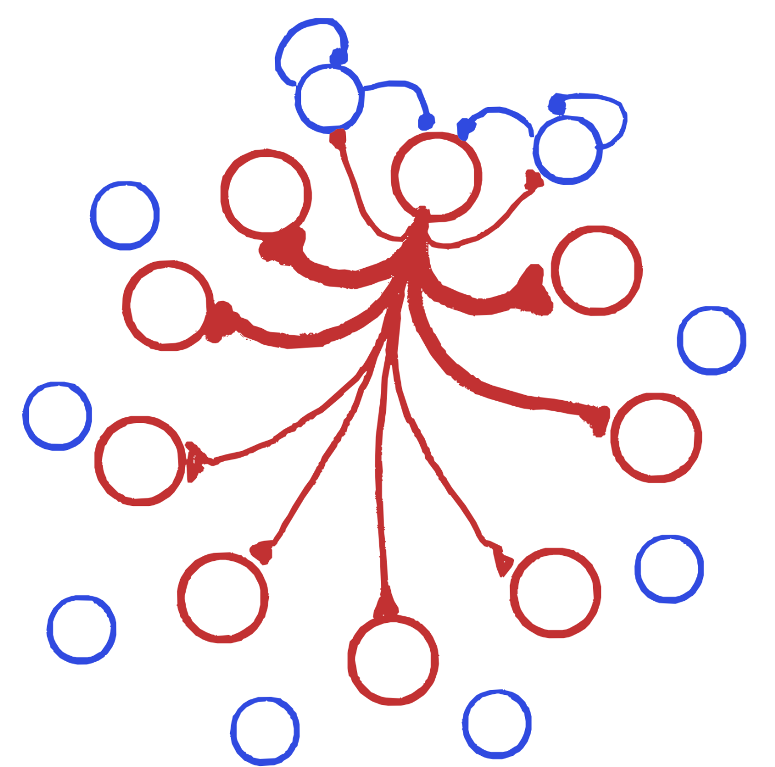
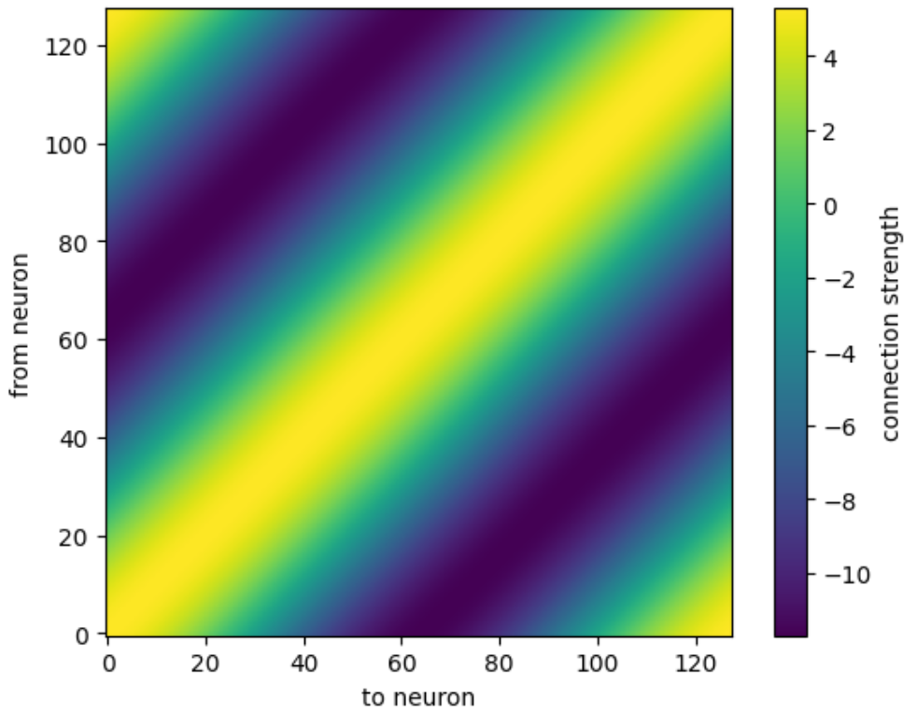
Ring attractor model
Connectivity matrix

Slide 40

Ring attractor model: parametric working memory
Connectivity matrix
Network simulation: one trial

Slide 41

Ring attractor model: parametric working memory
Network activity: bump attractor
Network simulation: one trial

Slide 42

Ring attractor model: parametric working memory
Network activity: bump attractor
Network simulation: many trials

Slide 43


Ring attractor model: parametric working memory
Network simulation: many trials
Wimmer et al Nat Neurosci 2014

Slide 44
Attractor network models
Excitatory feedback network
Inhibitory-excitatory network
Double-well attractor
Ring attractor network
Slower dynamics: memory, integration
Inhibition stabilization: memory
Selective memory, decision making
Continuous memory

Slide 45
Attractor models
Partly taken from: Martino Sorbaro, TReND–CaMinA 2024; Johan John, MIT course; Seth W. Egger

